Slide 1
Capstone Project - The Battle of Neighborhoods (Week 2)
Anurag Srivastava

Slide 2
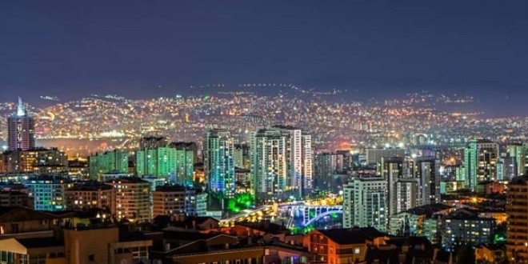
Introduction
This project is for who is planning to open a Coffee House in Ankara, Turkey.
This project suggests the best locations for Coffee Houses in Ankara. Ankara is the capital of Turkey with a population of 5M.
This report explores which neighborhoods of Ankara have the most as well as the best Coffee Houses.
Also, this project answers the questions “Where should I open a Coffee House?” and “Where should I stay If I want a tasty coffee?”

Slide 3
Data
District of Ankara are obtained from https://en.wikipedia.org/wiki/Ankara_Province[1]
Latitude and Longitude values are obtained by using "geocoder".
All data related to locations are obtained by using Foursquare API and Python Libraries. [2]

Slide 4
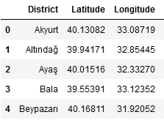
Methodology
Master data which includes “District”, “Latitude” and “Longitude” information of Ankara.
Python Folium library was used to visualize map of Ankara and its districts. In order to get Latitude and Longitudes of Ankara, geopy and geocoder are used. The map below was obtained.
In order to explore and categorize places Foursquare API was used. Limit was set to 100 and Radius was set to 500. Here is a head of the list Venues name, category, latitude and longitude information from Forsquare API. 15 venues are returned.

Slide 5
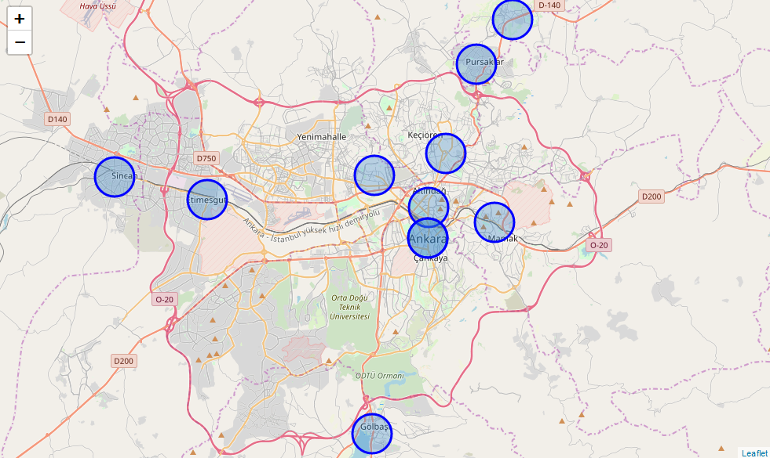
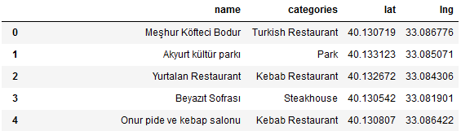
Methodology

Slide 6
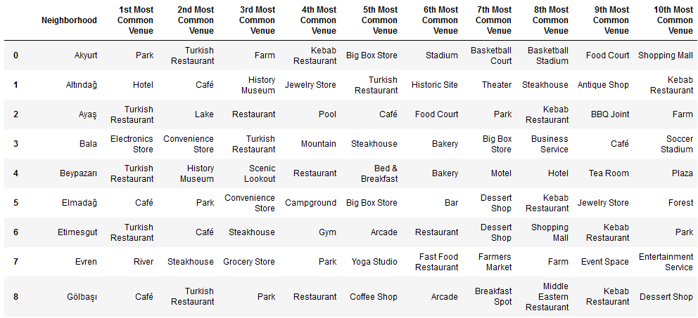

Slide 7
Methodology
There are common venues in districts, so unsupervised K-means algorithm was used to cluster districts. K-Means cluster was set to 3 clusters, to reach optimum accuracy.
Cluster 0: “Cafe” and “Plaza”
Cluster 1: “Café” “Restaurant” and “Park”
Cluster 2: “Turkish Restaurant” and “Bistro”

Slide 8
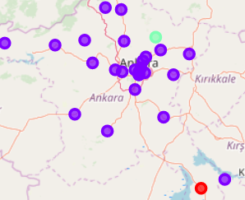
Results
Cluster 1 includes most of the districts. Cafes are most common venues in Cluster 1.

Slide 9
Discussion and Conclusion
Kmeans algorithm was used as part of this clustering study. K value was set to 3. For more detailed and accurate guidance, the data set can be expanded, and the details of the neighbourhood or street can also be drilled.
It is obvious that Cluster 1 is the most viable clusters to open a new coffee house. Especially Cluster 1 districts which have most common venues not Café such as Ayaş and Akyurt.

